Slide 1

Empower your cloud automation with Azure Blueprints
Yoann Guillo
Freelance

Slide 2
Yoann Guillo
Independant Cloud Architect, MVP Microsoft Azure, member of aOS community and member of the Microsoft User Group Rennes.
Working on the Azure platform since 2013.
Fanboy of automation (PowerShell & ARM templates)
Twitter : @YoannGUILLO
LinkedIn : https://www.linkedin.com/in/yoannguillo/
Blog : www.geneziis.com
GitHub : https://github.com/YoannGUILLO

Slide 3
Quick reminder
Yoann guillo

Slide 4


Azure Blueprints ?
Blueprints are a declarative way to orchestrate :
Role Assignments
Policy Assignments
Azure Resource Manager templates
Resource Groups
Role-based access controls
Policy Definitions
Subscription A
ARM Templates
Azure Blueprints
Subscription B
Subscription C
…
compose
manage
scale

Slide 5
Did you know that ?
We can use a nested deployments inside an ARM Templates in Blueprints.
Usage example :
Deploy a Hub & Spoke network

Slide 6
Demo
Yoann Guillo

Slide 7
You don’t know that…
We can assign a Blueprints using an ARM Template !
"type": "Microsoft.Blueprint/blueprintAssignments"

Slide 8
Demo
Yoann Guillo

Slide 9
Play yourself !
Find the code used in this demo on my Github !
https://github.com/YoannGUILLO/Community
Thank you !

Slide 11
Title square photo layout
Smaller text

Slide 12
Square photo layout

Slide 13
Slide palette info
The PowerPoint palette for this template has been built for you and is shown below.
Avoid using too many colors in your presentation.
PowerPoint Theme Accent colors
Accent 1
Accent 2
Accent 3
Accent 4
Accent 5
Accent 6
Use Accent 1 as the main accent color.
Use Accent 2 and Accent 3 only when additional colors are needed.
Use Accents 4-6 sparingly

Slide 14
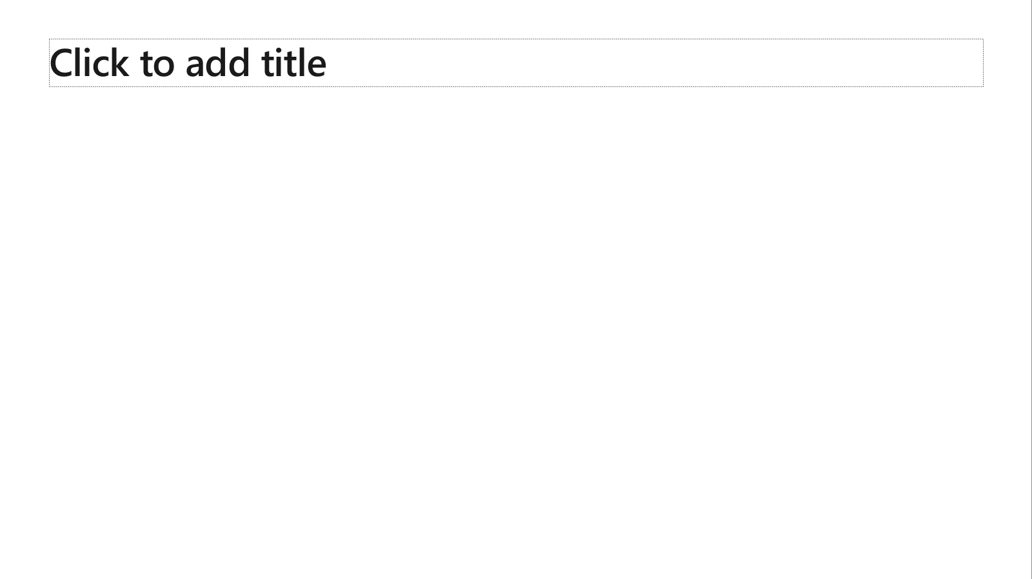
Ensure slide content is accessible
Take the following steps to create accessible content that everyone can consume effectively.
Contrast
Use high contrast colors for maximum readability
The recommended contrast ratio is at least 4.5:1
Shape and color
Use different shapes with a legend to indicate statuses to accommodate for color blindness
Example:
Alt text
Alt text helps people with screen readers understand the content of slides
You should create alternative text for shapes, pictures, charts, tables, SmartArt graphics, or other objects
Here’s how:
Right click on item
Select Edit Alt Text
Enter a Description
If an object is meant to add visual styling and doesn’t contain meaning (e.g. stylistic borders), do not add alt text and instead check Mark as decorative
Slide layouts
Using a built-in slide layout that matches your content ensures a hierarchical reading order of text blocks
Example:
If a new slide will have a title, rather than starting with a blank layout and adding a text block for the title, choose one of the built-in layouts with a title placeholder
Reading order
Screen readers describe content on the screen in the order it was created
To ensure your content is read back in the order you prefer, arrange your objects in the Selection Pane appropriately. Objects on the bottom of the selection pane are read first
Here’s how:
Click the Home tab
In the Drawing group, select the Arrange drop-down menu
Click Selection Pane…
Text
Text
Text
Subject 1
Subject 2
Subject 3
Color Contrast Analyzer
Download this tool to determine the legibility of text and the contrast of visual elements
Download
C1
C2
C3
Additional tips
Be sure to run the Accessibility Checker! Go to File click the Check for Issues drop down menu click Check Accessibility
Videos need to be accessible: If your presentation includes a video, ensure it is captioned and audio described (if appropriate)
Visit the Office Accessibility Center to learn more about accessibility in PowerPoint

Slide 15
Brand and accent colors accessibility
Type and background combinations must meet a minimum 4.5:1 contrast ratio to help ensure people of all abilities can access and understand our communications.
Pick colors carefully and avoid relying on color alone to convey information. Always provide text or other graphical cues to guide customers to our message.
Examples demonstrate correct color use for on-screen applications.
Get the Color Contrast Analyzer
Get more information on accessibility
Get the Microsoft color guidelines PDF
Dark Orange
Rich Black
R255 G147 B73 Hex #FF9349
Dark Yellow
Rich Black
R254 G240 B0 Hex #FEF000
Dark Green
Rich Black
R155 G240 B11 Hex #9BF00B
Dark Teal
Rich Black
R48 G229 B208 Hex #30E5D0
Dark Blue
Rich Black
R80 G230 B255 Hex #50E6FF
Dark Purple
Rich Black
R213 G157 B255 Hex #D59DFF
White
Rich Black
R216 G59 B1
Hex #D83B01
Rich Black
R255 G185 B0
Hex #FFB900
White
R16 G124 B16
Hex #107C10
White
Rich Black
R0 G133 B117
Hex #008575
White
Rich Black
R0 G120 B212
Hex #0078D4
White
Rich Black
R134 G97 B197
Hex #8661C5
Light Orange
White
R107 G41 B41 Hex #6B2929
Light Yellow
White
R106 G75 B22 Hex #6A4B16
Light Green White
R5 G75 B22 Hex #054B16
Light Teal
White
R39 G75 B71 Hex #274B47
Light Blue
White
R36 G58 B94 Hex #243A5E
Light Purple
White
R59 G46 B88 Hex #3B2E58
White
R255 G255 B255
Hex #FFFFFF
Orange
Dark Orange
Dark Yellow
Green
Dark Green
Teal
Dark Teal
Blue
Dark Blue
Purple
Dark Purple
Rich Black
R0 G0 B0
Hex #000000
White
Light Orange
Orange
White
Light Yellow
Yellow
White
Light Green
White
Light Teal
Teal
White
Light Blue
Blue
White
Light Purple
Purple
Extra Light Gray
R242 G242 B242
Hex #F2F2F2
Light Gray
R230 G230 B230
Hex #E6E6E6
Gray
R210 G210 B210
Hex #D2D2D2
Mid Gray
R115 G115 B115
Hex #737373
Dark Gray
R80 G80 B80
Hex #505050
Extra Dark Gray
R47 G47 B47
Hex #2F2F2F

Slide 16





PowerPoint Design Ideas
Get suggestions for slides
PowerPoint Designer can create suggestions for your slide content.
To access Design Ideas, click the “Design” tab in the Ribbon and then “Design Ideas” on the right.
Designer will also trigger when you insert an image.

Slide 17

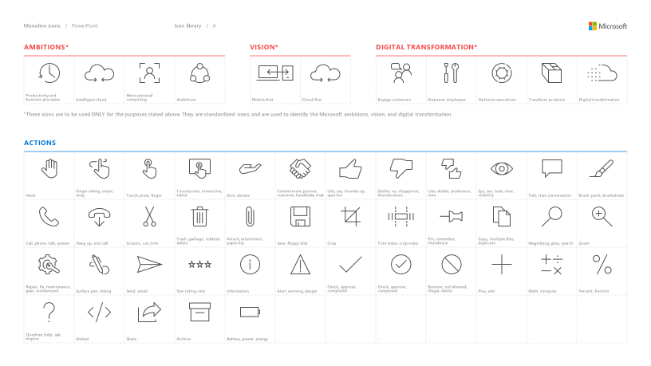
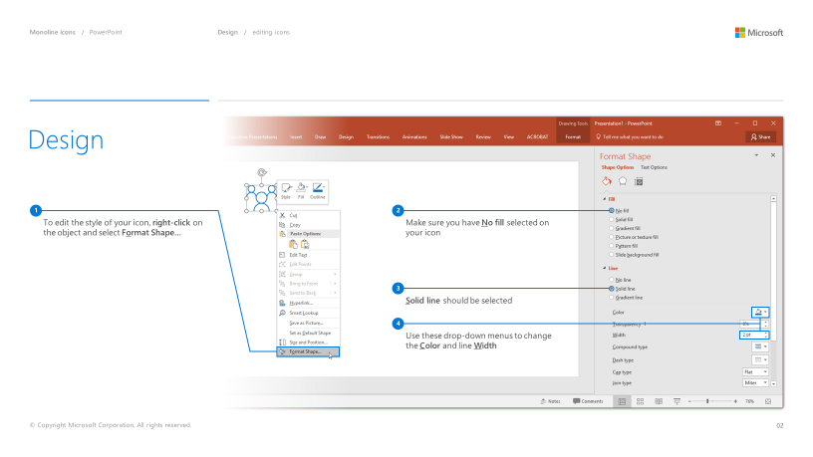
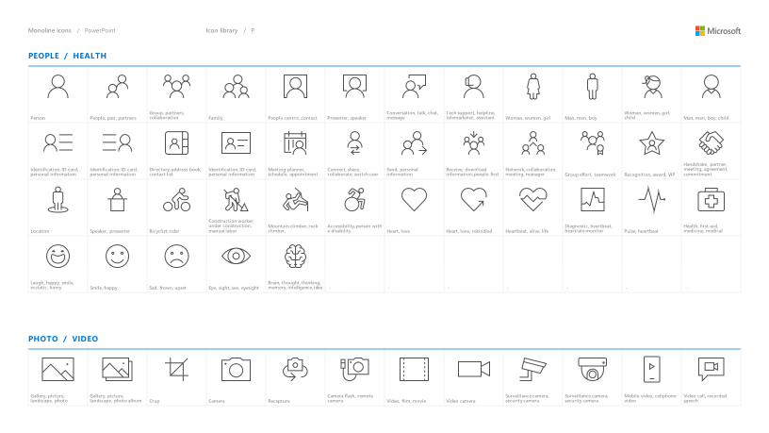
Microsoft monoline icons
Looking for icon resources?
The Monoline icon library for PowerPoint is a slide deck that provides a library of icons for use in PowerPoint presentations.
The Monoline icon style guide for PowerPoint is a pdf with additional guidelines.
Download both from Brand Central.

Slide 18
Demo
Speaker name

Slide 19
Section title

Slide 20
Software code slide
This slide layout uses Consolas, a monotype font which is ideal for showing software code.

Slide 21
Notes (hidden)
Some speakers at Microsoft like to use this slide for hidden “notes slides”.
Delete it if you don’t want to use it.
NEXT: <next slide title>

Slide 23
Presentation title
Speaker name
Title

Slide 24
Presentation title
Speaker name
Title

Slide 25
Presentation title
Speaker name
Title

Slide 26
Presentation title
Speaker name
Title

Slide 27
Text layout (without bullet points)
Main topic: Segoe UI, size 28pt
Segoe UI, size 20pt for second level
Segoe UI, size 16pt for third level

Slide 28
Text layout with bulleted text
Main topic: Segoe UI, size 28pt
Segoe UI, size 20pt for second level
Segoe UI, size 16pt for third level

Slide 29
Example with longer headline text wrapping to a second line
When the headline text is 2 lines, move this text block down to align to the lower blue guide
If you don’t see guidelines, click on the View menu, and then check the box in front of “Guides”
Use a “soft return” Shift + Enter to wrap text without adding extra line spacing

Slide 30
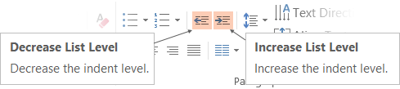
Adjusting list levels
Main topic: Segoe UI, size 28pt
Segoe UI, size 20pt for second level
Segoe UI, size 16pt for third level
Use the “Decrease List Level” and “Increase List Level” tools on the Home menu to change text levels.
Try this:
Place your cursor in the line of text that says “Segoe UI, size 20pt for second level”
Next click the Home tab, and then on the “Decrease List level” tool. Notice how the line moves up one level.
Now try placing your cursor in one of the top “Main topic…” line of text. Click the “Increase List Level” tool and see how the text is pushed in one level.
Use these 2 tools to adjust your text levels as you work

Slide 31
Bullet points layout with subtitle Set the subtitle to 20pt in the same text block, with character spacing Normal
Move the text block down vertically to align to lower guide
If you don’t see guidelines, click on the View menu, and then check the box in front of “Guides”
Hyperlink style: www.microsoft.com

Slide 32
Title square photo layout
Smaller text

Slide 33
Square photo layout

Slide 34
Slide palette info
The PowerPoint palette for this template has been built for you and is shown below.
Avoid using too many colors in your presentation.
PowerPoint Theme Accent colors
Accent 1
Accent 2
Accent 3
Accent 4
Accent 5
Accent 6
Use Accent 1 as the main accent color.
Use Accent 2 and Accent 3 only when additional colors are needed.
Use Accents 4-6 sparingly

Slide 35
Ensure slide content is accessible
Take the following steps to create accessible content that everyone can consume effectively.
Contrast
Use high contrast colors for maximum readability
The recommended contrast ratio is at least 4.5:1
Shape and color
Use different shapes with a legend to indicate statuses to accommodate for color blindness
Example:
Alt text
Alt text helps people with screen readers understand the content of slides
You should create alternative text for shapes, pictures, charts, tables, SmartArt graphics, or other objects
Here’s how:
Right click on item
Select Edit Alt Text
Enter a Description
If an object is meant to add visual styling and doesn’t contain meaning (e.g. stylistic borders), do not add alt text and instead check Mark as decorative
Slide layouts
Using a built-in slide layout that matches your content ensures a hierarchical reading order of text blocks
Example:
If a new slide will have a title, rather than starting with a blank layout and adding a text block for the title, choose one of the built-in layouts with a title placeholder
Reading order
Screen readers describe content on the screen in the order it was created
To ensure your content is read back in the order you prefer, arrange your objects in the Selection Pane appropriately. Objects on the bottom of the selection pane are read first
Here’s how:
Click the Home tab
In the Drawing group, select the Arrange drop-down menu
Click Selection Pane…
Text
Text
Text
Subject 1
Subject 2
Subject 3
Color Contrast Analyzer
Download this tool to determine the legibility of text and the contrast of visual elements
Download
C1
C2
C3
Additional tips
Be sure to run the Accessibility Checker! Go to File click the Check for Issues drop down menu click Check Accessibility
Videos need to be accessible: If your presentation includes a video, ensure it is captioned and audio described (if appropriate)
Visit the Office Accessibility Center to learn more about accessibility in PowerPoint

Slide 36
Brand and accent colors accessibility
Type and background combinations must meet a minimum 4.5:1 contrast ratio to help ensure people of all abilities can access and understand our communications.
Pick colors carefully and avoid relying on color alone to convey information. Always provide text or other graphical cues to guide customers to our message.
Examples demonstrate correct color use for on-screen applications.
Get the Color Contrast Analyzer
Get more information on accessibility
Get the Microsoft color guidelines PDF
Dark Orange
Rich Black
R255 G147 B73 Hex #FF9349
Dark Yellow
Rich Black
R254 G240 B0 Hex #FEF000
Dark Green
Rich Black
R155 G240 B11 Hex #9BF00B
Dark Teal
Rich Black
R48 G229 B208 Hex #30E5D0
Dark Blue
Rich Black
R80 G230 B255 Hex #50E6FF
Dark Purple
Rich Black
R213 G157 B255 Hex #D59DFF
White
Rich Black
R216 G59 B1
Hex #D83B01
Rich Black
R255 G185 B0
Hex #FFB900
White
R16 G124 B16
Hex #107C10
White
Rich Black
R0 G133 B117
Hex #008575
White
Rich Black
R0 G120 B212
Hex #0078D4
White
Rich Black
R134 G97 B197
Hex #8661C5
Light Orange
White
R107 G41 B41 Hex #6B2929
Light Yellow
White
R106 G75 B22 Hex #6A4B16
Light Green White
R5 G75 B22 Hex #054B16
Light Teal
White
R39 G75 B71 Hex #274B47
Light Blue
White
R36 G58 B94 Hex #243A5E
Light Purple
White
R59 G46 B88 Hex #3B2E58
White
R255 G255 B255
Hex #FFFFFF
Orange
Dark Orange
Dark Yellow
Green
Dark Green
Teal
Dark Teal
Blue
Dark Blue
Purple
Dark Purple
Rich Black
R0 G0 B0
Hex #000000
White
Light Orange
Orange
White
Light Yellow
Yellow
White
Light Green
White
Light Teal
Teal
White
Light Blue
Blue
White
Light Purple
Purple
Extra Light Gray
R242 G242 B242
Hex #F2F2F2
Light Gray
R230 G230 B230
Hex #E6E6E6
Gray
R210 G210 B210
Hex #D2D2D2
Mid Gray
R115 G115 B115
Hex #737373
Dark Gray
R80 G80 B80
Hex #505050
Extra Dark Gray
R47 G47 B47
Hex #2F2F2F

Slide 37
PowerPoint Design Ideas
Get suggestions for slides
PowerPoint Designer can create suggestions for your slide content.
To access Design Ideas, click the “Design” tab in the Ribbon and then “Design Ideas” on the right.
Designer will also trigger when you insert an image.

Slide 38
Microsoft monoline icons
Looking for icon resources?
The Monoline icon library for PowerPoint is a slide deck that provides a library of icons for use in PowerPoint presentations.
The Monoline icon style guide for PowerPoint is a pdf with additional guidelines.
Download both from Brand Central.

Slide 39
Demo
Speaker name

Slide 40
Section title

Slide 41
Software code slide
This slide layout uses Consolas, a monotype font which is ideal for showing software code.

Slide 42
Notes (hidden)
Some speakers at Microsoft like to use this slide for hidden “notes slides”.
Delete it if you don’t want to use it.
NEXT: <next slide title>

Slide 45
Presentation title
Speaker name
Title

Slide 46
Presentation title
Speaker name
Title

Slide 47
Presentation title
Speaker name
Title

Slide 48
Presentation title
Speaker name
Title

Slide 49
Text layout (without bullet points)
Main topic: Segoe UI, size 28pt
Segoe UI, size 20pt for second level
Segoe UI, size 16pt for third level

Slide 50
Text layout with bulleted text
Main topic: Segoe UI, size 28pt
Segoe UI, size 20pt for second level
Segoe UI, size 16pt for third level

Slide 51
Example with longer headline text wrapping to a second line
When the headline text is 2 lines, move this text block down to align to the lower blue guide
If you don’t see guidelines, click on the View menu, and then check the box in front of “Guides”
Use a “soft return” Shift + Enter to wrap text without adding extra line spacing

Slide 52
Adjusting list levels
Main topic: Segoe UI, size 28pt
Segoe UI, size 20pt for second level
Segoe UI, size 16pt for third level
Use the “Decrease List Level” and “Increase List Level” tools on the Home menu to change text levels.
Try this:
Place your cursor in the line of text that says “Segoe UI, size 20pt for second level”
Next click the Home tab, and then on the “Decrease List level” tool. Notice how the line moves up one level.
Now try placing your cursor in one of the top “Main topic…” line of text. Click the “Increase List Level” tool and see how the text is pushed in one level.
Use these 2 tools to adjust your text levels as you work

Slide 53
Bullet points layout with subtitle Set the subtitle to 20pt in the same text block, with character spacing Normal
Move the text block down vertically to align to lower guide
If you don’t see guidelines, click on the View menu, and then check the box in front of “Guides”
Hyperlink style: www.microsoft.com

Slide 54
Title square photo layout
Smaller text

Slide 55
Square photo layout

Slide 56
Slide palette info
The PowerPoint palette for this template has been built for you and is shown below.
Avoid using too many colors in your presentation.
PowerPoint Theme Accent colors
Accent 1
Accent 2
Accent 3
Accent 4
Accent 5
Accent 6
Use Accent 1 as the main accent color.
Use Accent 2 and Accent 3 only when additional colors are needed.
Use Accents 4-6 sparingly

Slide 57
Ensure slide content is accessible
Take the following steps to create accessible content that everyone can consume effectively.
Contrast
Use high contrast colors for maximum readability
The recommended contrast ratio is at least 4.5:1
Shape and color
Use different shapes with a legend to indicate statuses to accommodate for color blindness
Example:
Alt text
Alt text helps people with screen readers understand the content of slides
You should create alternative text for shapes, pictures, charts, tables, SmartArt graphics, or other objects
Here’s how:
Right click on item
Select Edit Alt Text
Enter a Description
If an object is meant to add visual styling and doesn’t contain meaning (e.g. stylistic borders), do not add alt text and instead check Mark as decorative
Slide layouts
Using a built-in slide layout that matches your content ensures a hierarchical reading order of text blocks
Example:
If a new slide will have a title, rather than starting with a blank layout and adding a text block for the title, choose one of the built-in layouts with a title placeholder
Reading order
Screen readers describe content on the screen in the order it was created
To ensure your content is read back in the order you prefer, arrange your objects in the Selection Pane appropriately. Objects on the bottom of the selection pane are read first
Here’s how:
Click the Home tab
In the Drawing group, select the Arrange drop-down menu
Click Selection Pane…
Text
Text
Text
Subject 1
Subject 2
Subject 3
Color Contrast Analyzer
Download this tool to determine the legibility of text and the contrast of visual elements
Download
C1
C2
C3
Additional tips
Be sure to run the Accessibility Checker! Go to File click the Check for Issues drop down menu click Check Accessibility
Videos need to be accessible: If your presentation includes a video, ensure it is captioned and audio described (if appropriate)
Visit the Office Accessibility Center to learn more about accessibility in PowerPoint

Slide 58
Brand and accent colors accessibility
Type and background combinations must meet a minimum 4.5:1 contrast ratio to help ensure people of all abilities can access and understand our communications.
Pick colors carefully and avoid relying on color alone to convey information. Always provide text or other graphical cues to guide customers to our message.
Examples demonstrate correct color use for on-screen applications.
Get the Color Contrast Analyzer
Get more information on accessibility
Get the Microsoft color guidelines PDF
Dark Orange
Rich Black
R255 G147 B73 Hex #FF9349
Dark Yellow
Rich Black
R254 G240 B0 Hex #FEF000
Dark Green
Rich Black
R155 G240 B11 Hex #9BF00B
Dark Teal
Rich Black
R48 G229 B208 Hex #30E5D0
Dark Blue
Rich Black
R80 G230 B255 Hex #50E6FF
Dark Purple
Rich Black
R213 G157 B255 Hex #D59DFF
White
Rich Black
R216 G59 B1
Hex #D83B01
Rich Black
R255 G185 B0
Hex #FFB900
White
R16 G124 B16
Hex #107C10
White
Rich Black
R0 G133 B117
Hex #008575
White
Rich Black
R0 G120 B212
Hex #0078D4
White
Rich Black
R134 G97 B197
Hex #8661C5
Light Orange
White
R107 G41 B41 Hex #6B2929
Light Yellow
White
R106 G75 B22 Hex #6A4B16
Light Green White
R5 G75 B22 Hex #054B16
Light Teal
White
R39 G75 B71 Hex #274B47
Light Blue
White
R36 G58 B94 Hex #243A5E
Light Purple
White
R59 G46 B88 Hex #3B2E58
White
R255 G255 B255
Hex #FFFFFF
Orange
Dark Orange
Dark Yellow
Green
Dark Green
Teal
Dark Teal
Blue
Dark Blue
Purple
Dark Purple
Rich Black
R0 G0 B0
Hex #000000
White
Light Orange
Orange
White
Light Yellow
Yellow
White
Light Green
White
Light Teal
Teal
White
Light Blue
Blue
White
Light Purple
Purple
Extra Light Gray
R242 G242 B242
Hex #F2F2F2
Light Gray
R230 G230 B230
Hex #E6E6E6
Gray
R210 G210 B210
Hex #D2D2D2
Mid Gray
R115 G115 B115
Hex #737373
Dark Gray
R80 G80 B80
Hex #505050
Extra Dark Gray
R47 G47 B47
Hex #2F2F2F

Slide 59
PowerPoint Design Ideas
Get suggestions for slides
PowerPoint Designer can create suggestions for your slide content.
To access Design Ideas, click the “Design” tab in the Ribbon and then “Design Ideas” on the right.
Designer will also trigger when you insert an image.

Slide 60
Microsoft monoline icons
Looking for icon resources?
The Monoline icon library for PowerPoint is a slide deck that provides a library of icons for use in PowerPoint presentations.
The Monoline icon style guide for PowerPoint is a pdf with additional guidelines.
Download both from Brand Central.

Slide 61
Section title

Slide 62
Software code slide
This slide layout uses Consolas, a monotype font which is ideal for showing software code.

Slide 63
Notes (hidden)
Some speakers at Microsoft like to use this slide for hidden “notes slides”.
Delete it if you don’t want to use it.
NEXT: <next slide title>

Slide 64
Demo
Speaker name

